Slide 1
PART 0
Course Orientation
Understanding our university, our course, and how you'll be evaluated this semester.

Slide 2
COURSE ORIENTATION
Mandate
Our Mandate
To provide advanced education, higher technological, professional instruction and training in fisheries technology, arts and sciences, education, industrial technology, engineering, aquaculture, seaweed farming, and related fields relevant to national development. The university also undertakes research, extension services, and production activities supporting the development of Iloilo Province.

Slide 3
COURSE ORIENTATION
Vision & Mission
Vision
Mission
A leading and empowering research university in fisheries, agriculture, education, maritime studies, arts, sciences, and technology in Southeast Asia by 2030.
(BOR Reso. No. 209, s. 2025)
To produce globally competitive and empowered graduates in fisheries, agriculture, education, maritime studies, arts, sciences, and technology, and to capacitate individuals and communities toward sufficiency for nation building.
(BOR Reso. No. 209, s. 2025)

Slide 4
COURSE ORIENTATION
Guiding Principles
I
S
D
A
Integrity
Social Justice
Discipline
Academic Excellence

Slide 5
COURSE ORIENTATION
Quality Policy Statement
Our Commitment
The ISUFST is committed to providing advanced education and professional training relevant to regional and national development, satisfying applicable statutory and regulatory requirements. The university undertakes research, extension, and production services supporting the Province of Iloilo and the country, providing progressive leadership in its areas of specialization. Management ensures continuous improvement and customer satisfaction through compliance with its quality management system.
(BOR Res. No. 97, s. 2018)

Slide 6
COURSE ORIENTATION
Institutional Objectives
1
Produce quality graduates who contribute to the advancement of their chosen field.
2
Conduct viable research, develop and disseminate technologies, and provide technical assistance for increased production.
3
Offer curricular programs responsive to community and industry needs.
4
Promote self-employment and entrepreneurship.
5
Strengthen scholarships and training opportunities for students, faculty, and staff.
6
Develop linkages with agencies and institutions, nationally and internationally.
7
Improve facilities that support quality instruction, research, extension, and production.

Slide 7
COURSE ORIENTATION
Program Outcomes — BSIT (1 of 2)
Apply knowledge of computing, science, and mathematics appropriate to the discipline.
Understand best practices and standards and their applications.
Analyze complex problems and identify computing requirements for their solution.
Identify and analyze user needs for the design of computer-based systems.
Design, implement, and evaluate computer-based systems and processes.
Integrate IT-based solutions effectively into the user environment.

Slide 8
COURSE ORIENTATION
Program Outcomes — BSIT (2 of 2)
Apply current techniques, skills, tools, and practices necessary for the IT profession.
Function effectively as a member or leader of a development team.
Assist in creating an effective IT project plan.
Communicate effectively with the computing community and society at large.
Analyze the local and global impact of computing on individuals and society.
Understand professional, ethical, legal, and security responsibilities in IT.
Engage in self-learning as a foundation for continuing professional development.

Slide 9
COURSE ORIENTATION
Course Outcomes
1
Explain the fundamental concepts, components, functions, and importance of databases and DBMS.
2
Analyze data requirements and design relational database models using ERDs.
3
Apply normalization techniques to organize data and improve database integrity.
4
Create and manipulate relational databases using MySQL and basic SQL statements.
5
Retrieve, update, and manage data using SQL while applying database design principles.

Slide 10
COURSE ORIENTATION
Course Requirements / Outputs
Quizzes
Seatworks
Laboratory exercises
Activities
Midterm examination
Final examination
Database project proposal
Final Database project & presentation

Slide 11
COURSE ORIENTATION
Grading System
Lecture
Laboratory
Midterm & Final Exam
40%
Laboratory Exercises
30%
Quizzes & Activities
30%
Practical Exam
30%
Outputs & Projects
20%
Project
40%
Oral Participation / Attendance
10%
Overall Grade: Lecture 40% + Laboratory 60%

Slide 12
COURSE ORIENTATION
Laboratory Policies
Inside the Laboratory
During Activities
No eating or drinking.
Handle computers carefully.
Do not install unauthorized software.
Save your work often.
Keep your workspace clean.
Follow instructions.
Ask questions if you need help.
No copying another student's work.
Practice academic honesty.

Slide 13
COURSE ORIENTATION
Class Expectations
Respect
Attendance and Punctuality
Active Participation
Preparation
Responsibility for Your Own Learning
Academic Honesty
Proper Use of Technology
Communication
Deadlines
Mistakes are part of Learning

Slide 14
IT2108
Fundamentals of
Database
Unit 1: Database Foundations
DATA
INFORMATION
DATABASE
DBMS

Slide 15
UNIT 1 · LEARNING OBJECTIVES
By the End of This Unit, You Can:
Distinguish between data and information
Define what a database and a DBMS are
Explain why databases matter in real-world systems
Compare file-based systems with database systems

Slide 16
Look at these four pieces:
18
Male
John
BSIT
This is where our unit begins →

Slide 17
UNIT 1 · DATABASE FOUNDATIONS
What Is Data?
Definition
Example
Data is a raw, unorganized fact that must be processed to become meaningful. Data are individual units of information; in analytical processes, they're represented by variables. Data contains numbers, statements, and characters in raw form.
John 18 BSIT Male
On their own, these values carry no context — they're just isolated facts waiting to be organized.

Slide 18
UNIT 1 · DATABASE FOUNDATIONS
What Is Information?
Definition
Example
Information is data that has been processed, organized, or structured so it becomes meaningful and useful for decision-making. It answers questions like who, what, when, and how much — data presented within a context that makes it relevant to the person who needs it.
"John, age 18, sex Male, is a BSIT student."
The same raw values now tell a complete, usable story.

Slide 19
UNIT 1 · QUICK CHECK
Try It Yourself
For each item below, decide: is it DATA or INFORMATION?
95, "Math", "Maria Santos"
DATA or INFORMATION?
Carol is a 20-year-old BSIT student
DATA or INFORMATION?
36°, “Jose"
DATA or INFORMATION?

Slide 20
UNIT 1 · DATABASE FOUNDATIONS
Data vs. Information
 | DATA | INFORMATION
Definition | Unstructured facts — text, observations, images, symbols. No meaning on its own. | Processed, organized, structured data. Gives context and supports decisions.
Purpose | Raw variables used to develop ideas and conclusions. | Meaningful data, ready to use.
Nature | Plain text and numeric values. | A refined, contextual form of data.

Slide 21
UNIT 1 · DATABASE FOUNDATIONS
What Is a Database?
Definition
Example
A database is an organized collection of related data, stored electronically and structured so it can be easily accessed, managed, retrieved, and updated. Databases are designed to minimize redundant data and represent real-world relationships between pieces of information.
A school database stores students, courses, and enrollments as separate but related collections of records — instead of one giant, unorganized list.
Notes:
Where can we find databases?
Expected answers
Schools
Banks
Hospitals
Facebook
Shopee
Airlines
Government offices

Slide 22
UNIT 1 · DATABASE FOUNDATIONS
Anatomy of a Database Table
A table is a collection of related data entries made of columns and rows.
Column (field / attribute): a vertical entity holding one type of value.
Row (record / tuple): a horizontal entity holding one individual ent.ry
StudentID | Name | Course | Age
2026-001 | John Cruz | BSIT | 18
2026-002 | Maria Santos | BSIT | 19
2026-003 | Carol Reyes | BSED | 20
Example: In the table above, one row is one student's complete record; one column (e.g. Course) holds the same type of value for every student.

Slide 23
UNIT 1 · DATABASE FOUNDATIONS
What Is a DBMS?
Definition
Example
A Database Management System (DBMS) is software that lets users and applications create, read, update, delete, and manage data — without needing to understand how it's physically stored. Examples: MySQL, PostgreSQL, Oracle, and Microsoft SQL Server. Related tables are linked based on common data; a DBMS is essentially a computerized record-keeping system.
When a registrar enrolls a new student, the interface calls the DBMS behind the scenes to safely insert that student's record into the database.

Slide 24
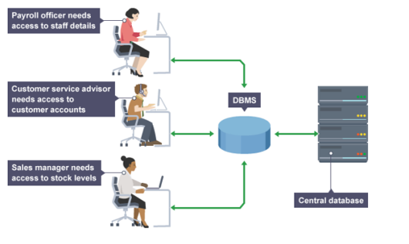
UNIT 1 · DATABASE FOUNDATIONS
One Database, Many Users
A database in a DBMS can be viewed by many different people with different responsibilities.
Departments, customers, and staff each need to see different kinds of data.
Each user gets a customized front-end application with their own level of access.

Slide 25
UNIT 1 · DATABASE FOUNDATIONS
Where Databases Are Used
Banking
Airlines
Universities
Accounts, loans, and everyday transactions.
Reservations and flight schedules.
Student records, registration, and grades.
Manufacturing
Human Resources
Online Retail
Supply chains, inventory, and orders.
Employee data, payroll, and benefits.
Orders, recommendations, and reviews.

Slide 26
UNIT 1 · DATABASE FOUNDATIONS
Enterprise Information Systems
Sales & Accounting
HR & Manufacturing
Online Retail
Sales: customer, product, and purchase information.
Accounting: payments, receipts, balances, assets, and other accounting records.
Human Resources: employee data, salaries, payroll taxes, benefits, and paychecks.
Manufacturing: supply chain management, production tracking, inventories, and orders.
Sales data plus order tracking, recommendation lists, and maintenance of online product evaluations.

Slide 27
UNIT 1 · DATABASE FOUNDATIONS
Banking, Finance & More
Banking & Credit
Finance
Universities & Airlines
Banking: customer information, accounts, loans, and transactions.
Credit cards: purchases and generation of monthly statements.
Storing holdings, sales, and purchases of stocks and bonds; real-time market data enabling online and automated trading.
Universities: student records, registration, and grades.
Airlines: reservations and schedules — among the first geographically distributed database users.

Slide 28
UNIT 1 · DATABASE FOUNDATIONS
Advantages of a DBMS (1 of 2)
Controlling Redundancy — Centralized data and control by the DBA avoid unnecessary duplication.
✓
Improved Data Sharing — A DBMS lets many application programs share the same data.
✓
Data Integrity — Centralized control lets the administrator define constraints so data stays accurate.
✓

Slide 29
UNIT 1 · DATABASE FOUNDATIONS
Advantages of a DBMS (2 of 2)
Security — Full authority over operational data lets the DBA enforce authorization checks on sensitive data.
✓
Data Consistency — Eliminating redundancy greatly reduces the chance of inconsistent data.
✓
Efficient Data Access & Standards — All access flows through the DBMS, and the DBA can enforce naming and quality standards.
✓

Slide 30
UNIT 1 · DATABASE FOUNDATIONS
Disadvantages of a DBMS
Complexity — Supporting many functions makes the underlying software complex to master.
!
Resource Cost — Complexity and functionality require large amounts of memory to run efficiently.
!
Centralized Risk & Generalization — Any DBMS failure impacts all users, and generalized software may run some applications slower.
!

Slide 31
UNIT 1 · DATABASE FOUNDATIONS
File System vs. Database System
FILE-BASED SYSTEM
DATABASE SYSTEM
students.txt
grades.xlsx
DBMS
enroll.csv
faculty.doc
Students
Courses
Enrollment
Example: In a file system, updating a student's address may mean editing five different files by hand. In a database, updating one Students table updates the information everywhere it's used.
Notes:
If Facebook stored every user's data in separate text files, what problems would happen?
Ans.
Slow
Duplicate records
Lost files
Hard to update

Slide 32
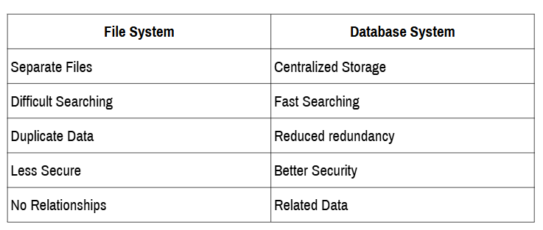
UNIT 1 · DATABASE FOUNDATIONS
File System vs. Database System

Slide 33
WRAP-UP
Review Questions
01
What is data?
05
What is a DBMS?
02
What is information?
06
Name three databases you use every day.
03
What is a database?
07
Why are databases important?
04
What is a table?

